Slide 1
About Me
By: Emily Jensen

Slide 2
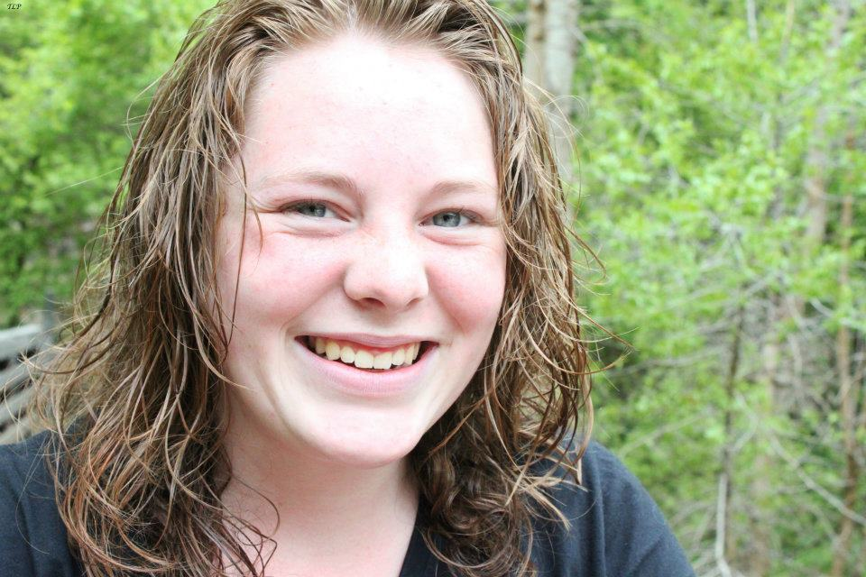
ME
Interests:
  Kayaking (family interest)
  Family
  Music
  Art

Slide 3
Hometown
Taylorsville: 3 years
West Bountiful: 13 years
Bountiful: 2 years

Slide 4
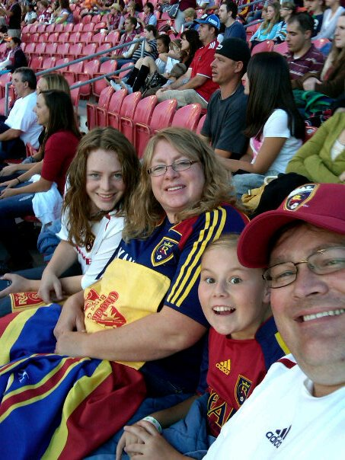
Family
Parents: Dave and Ame
Sister: Rebecca (12)
Dog: Sadie
Guinea Pig: Buster and Gandalf

Slide 5
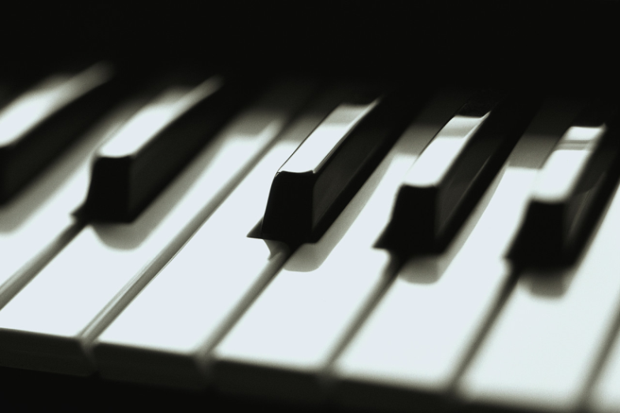
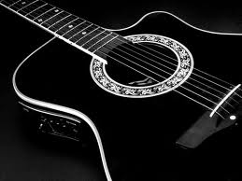
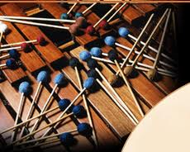
Music
A Family Passion

Slide 6
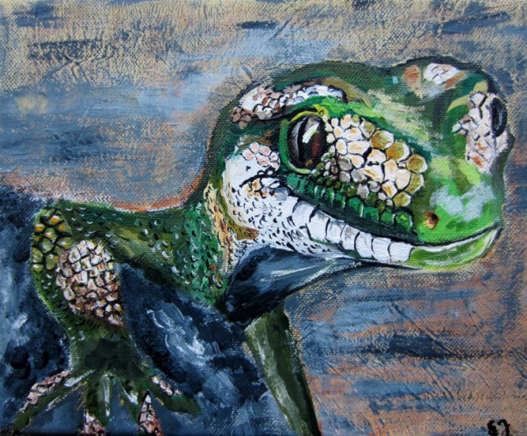
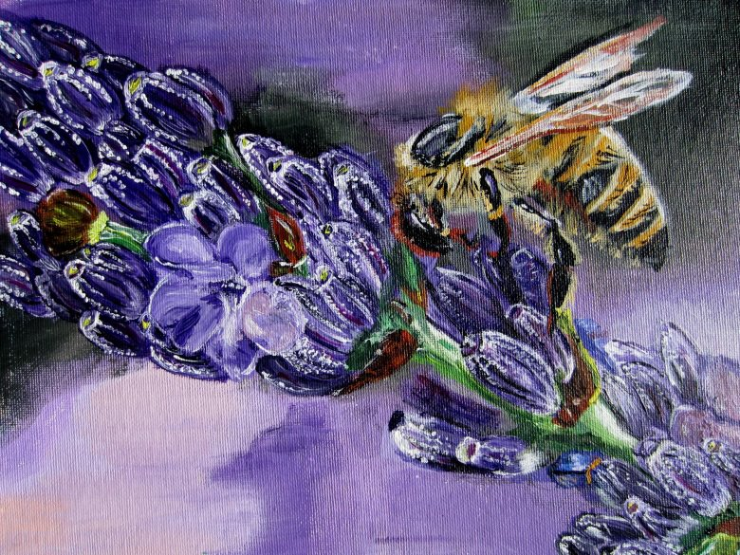
My Art
Another family passion
Art has not always been a passion, but when I
discovered I could paint, I took hold of the
opportunity to master the talent.

